Slide 1

Public Debt

Slide 2
Characteristics of Government Bonds

Slide 3
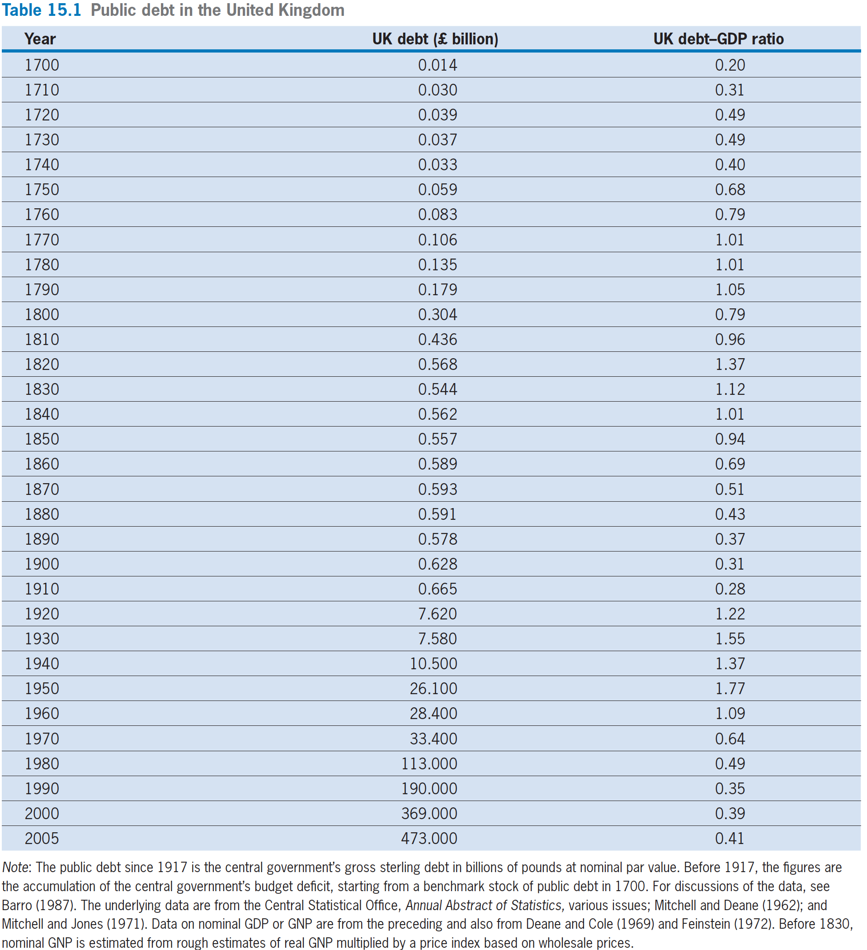
Characteristics of Government Bonds
The nominal quantity of interest-bearing debt, and the ratio of this debt to nominal GDP

Slide 4
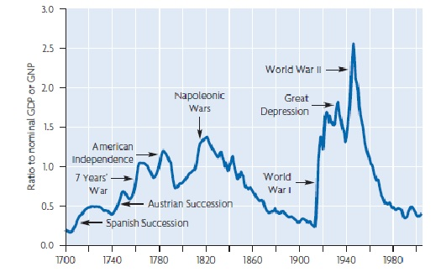
Characteristics of Government Bonds

Slide 5
Characteristics of Government Bonds
We assume that government bonds pay interest and principal in the same way as private bonds.
We assume that bondholders (households in our model) regard government bonds as equivalent to private bonds.

Slide 6
Characteristics of Government Bonds
total bond holdings= B_{t} + B^{g}_{t}
=private bonds+ government bonds
The quantity of private bonds held by all households is still zero, that is, B_{t} = 0 still holds in the aggregate.
total bond holdings of all households= B^{g}_{t}

Slide 7
Budget Constraints and Budget Deficits

Slide 8

Budget Constraints and Budget Deficits
The Government’s Budget Constraint
  Without debt: G_{t} + V_{t} = T_{t}
  The real value of these interest payments, i_{t−1}·(B^{g}_{t−1}/P_{t}) adds to the government’s expenditure or uses of funds on the left-hand side of the government’s budget constraint.
With public debt:
  G_{t} + V_{t} + i_{t−1}·(B^{g} _{t−1}/ P_{t} ) = T_{t} + (B^{g}_{t} −B^{g}_{t−1})/P_{t}
  real purchases+ real transfers+real interest payments = real taxes + real debt issue added

Slide 9
Budget Constraints and Budget Deficits
When nominal money, M_{t}, and the price level, P_{t}, do not change over time, the government’s budget constraint becomes.
    G_{t}+ V_{t}+ r_{t−1}·B^{g}_{t−1}/P =T_{t}+ (B^{g}_{t}− B^{g} _{t−1})/P

Slide 10
Budget Constraints and Budget Deficits
The Budget Deficit
  real government saving
  = T_{t} − G_{t} − V_{t} − r_{t−1}·B^{g}_{t−1}/P
  = − (B^{g}_{t} − B^{g}_{t−1})/P
  real government saving
  = real taxes− real government expenditure

Slide 11
Budget Constraints and Budget Deficits
The Budget Deficit
  If the government’s revenue exceeds its expenditure, then the government has a budget surplus.
  If the government has a balanced budget, then the government’s real saving is zero.

Slide 12
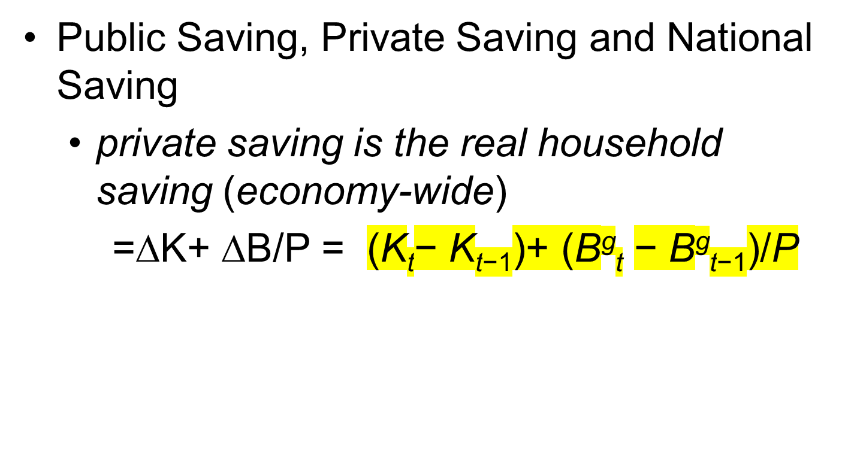
Budget Constraints and Budget Deficits

Slide 13
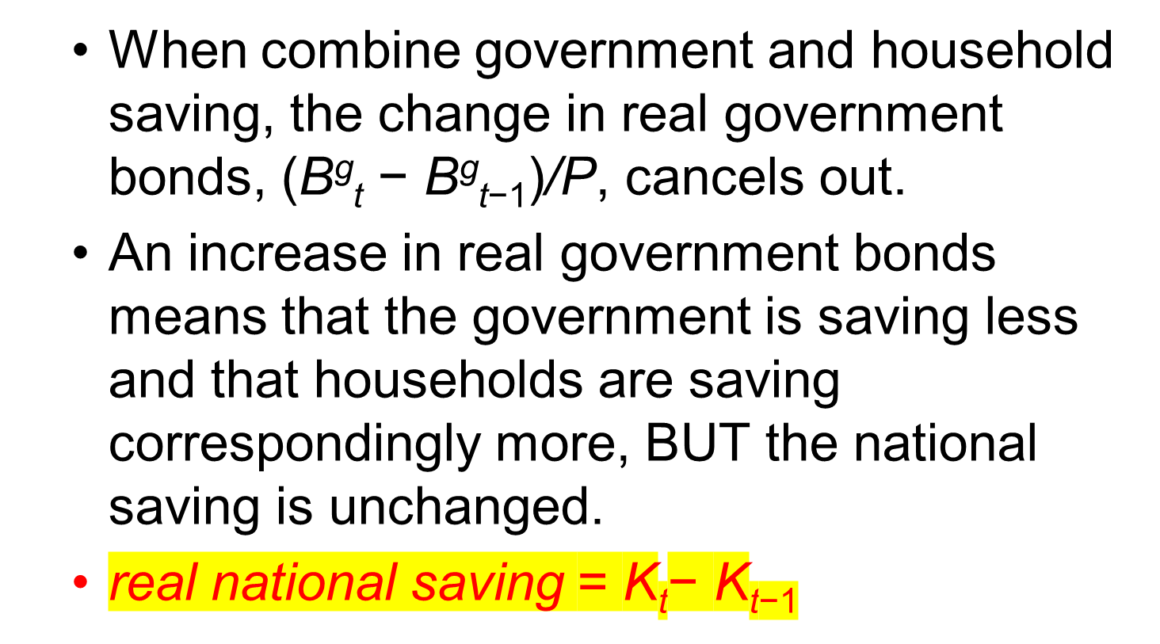
Budget Constraints and Budget Deficits

Slide 14
Budget Constraints and Budget Deficits
Household’s multiyear budget constraint without government bonds
  C₁ + C₂/(1+r₁) + · · · = (1+r₀)·(B₀/P+K₀)
  +(w/P)₁·L^{s}₁ +(w/P)₂ · L^{s}₂ /(1+r₁) + ···
  +(V₁ − T₁) + (V₂ − T₂)/(1 + r₁) +(V₃ − T₃)/[(1+ r₁) · (1 + r₂) ] + ···

Slide 15
Budget Constraints and Budget Deficits
multiyear household budget constraint with government bonds
  C₁ + C₂/(1+r₁) + ··· = (1+r₀)·(B₀/P+B^{g}₀/P+K₀)
  +(w/P)₁·L^{s}₁ +(w/P)₂ · L^{s}₂ /(1+r₁) + ···
  +(V₁−T₁) + (V₂−T₂)/(1 + r₁) +(V₃−T₃)/[(1+ r₁) · (1 + r₂) ] + ···

Slide 16
Budget Constraints and Budget Deficits
A Simple Case of Ricardian Equivalence
(李嘉图等价定理)
  The real interest rate, r_{t}, is the same each year: r₀ = r₁ = r₂ = · · · = r .
  M_{t}, and P_{t}, do not change over time. With a zero inflation rate, π, the real interest rate, r , equals the nominal rate, i .
  Real transfers, V_{t}, are zero each year, V=0.
  The government has a given time path of purchases, G_{t}

Slide 17
Budget Constraints and Budget Deficits
  Government Budget Constraint
    G_{t}+ V_{t}+ r_{t−1}·B^{g}_{t−1}/P =T_{t}+ (B^{g}_{t}− B^{g} _{t−1})/P
    Changes to:
    G_{t}+ r· B^{g}_{t−1}/P = T_{t}+ (B^{g}_{t}−B^{g}_{t−1}⁾/P
  The government starts with zero debt, B^{g}₀/P = 0. In year 1, the government real interest payments, r · (B^{g}₀/P), are zero, and the budget constraint
    G₁ = T₁ + B^{g}₁/P

Slide 18
Budget Constraints and Budget Deficits
  Suppose, to begin, that the government balances its budget each year, that is,
  public saving = T₁− G₁ = − B^{g}₁/P=0
  Then, in year 1, real purchases, G₁, equal real taxes, T₁
  Continuing on, if the government balances its budget every year, the real public debt, B^{g}_{t} /P, is zero in every year t.

Slide 19
Budget Constraints and Budget Deficits
If, instead of balancing its budget in year 1, the government runs a real budget deficit of one unit, that is,
public saving = T₁− G₁ = − B^{g}₁/P= − 1
The deficit must come from a cut in real taxes, T₁, by one unit since the government has to sustain a given time path of purchases, G_{t}.
The real deficit of one unit requires the government to issue one unit of real public debt at the end of year 1, so that B^{g}₁ /P = 1.

Slide 20
Budget Constraints and Budget Deficits
  Assume that the government decides to restore the public debt to zero from year 2 onward, so that B^{g}₂ /P = B^{g}₃ /P = · · · = 0, that is, in
  G₂ + r·B^{g}₁ /P = T₂ + (B^{g}₂−B^{g}₁)/P
    where B^{g}₁/P = 1 and B^{g}₂/P = 0
  Simplified Budget Constraint
    G₂ + r = T₂ − 1, that is, T₂ = G₂ + 1 + r
  The government must raise real taxes in year 2, T₂, above year 2’s government purchases, G₂, to pay the principal and interest, 1 + r , on the one unit of debt, B^{g}₁ /P, issued in year 1.

Slide 21
Budget Constraints and Budget Deficits
  Decrease in year 1 real taxes + present value of increase in year 2 taxes
  = −1 + (1 + r)/( 1 + r)
  = −1 + 1
  = 0

Slide 22
Budget Constraints and Budget Deficits
If the government replaces a unit of real taxes with a unit of real budget deficit (1个单位的国债), households know that the present value of next year’s real taxes will rise by one unit.
Thus, the real budget deficit is the same as a real tax in terms of the overall present value of real taxes.
This finding is the simplest version of the Ricardian equivalence theorem on the public debt.

Slide 23
Budget Constraints and Budget Deficits
More Generally
  C₁ + C₂/(1+r₁) + ··· = (1+r₀)·( B₀/P+B^{g}₀/P+K₀)
  +(w/P)₁·L^{s}₁ +(w/P)₂ · L^{s}₂ /(1+r₁) + ···
  +( V₁ − T₁) + ( V₂ − T₂)/( 1 + r₁) +( V₃ − T₃)/[(1+ r₁) · ( 1 + r₂) ] + ···
If the time path of government purchases, G_{t}, is given (and if real transfers, V_{t} ,are zero), we can show that a higher B^{g}₀/P requires the government to collect a correspondingly higher present value of real taxes, T_{t}, to finance the debt. This higher present value of real taxes exactly offsets the higher B^{g}₀/P .
Thus, we still have no income effects on households.

Slide 24
Economic Effects of a Budget Deficit

Slide 25
Economic Effects of a Budget Deficit
What happens in the equilibrium business-cycle model when the government cuts year 1 real taxes, T₁, to runs a budget deficit?
Economists often refer to this type of change as a simulative fiscal policy（扩张性或者刺激性财政政策）.

Slide 26
Economic Effects of a Budget Deficit
Lump-Sum Taxes
  the cut in year 1 real taxes, T₁, and the increases in future real taxes, T_{t} , all involve lump-sum taxes(一次性征税).
    these taxes are that they have no substitution effects on consumption and labor supply.
  We have found in our equilibrium business-cycle model that a deficit-financed （发国债）tax cut does not stimulate the economy. In particular, real GDP, Y, gross investment, I, and the real interest rate, r , do not change

Slide 27
Economic Effects of a Budget Deficit
Labor Income Taxes
  Instead of lump-sum taxes, the government levies taxes on labor income. Consider again a reduction in year 1 real taxes, T₁, financed by a budget deficit（发国债）.
  We assume that the fall in T₁ is accompanied by a decline in the marginal income tax rate, (τ_{w})₁.
  The changes in marginal income tax rates, (τ_{w})₁, affect the labor market in years 1.

Slide 28
Economic Effects of a Budget Deficit
  The decrease in (τ_{w})₁ increases labor supply in year 1. This increase in labor supply leads, when the labor market clears, to a higher quantity of labor, (L₁).
  And the capital input is also increased, why?
  Thus leads to an increase in year 1’s real GDP, Y₁.

Slide 29
Economic Effects of a Budget Deficit
  A budget deficit （发国债）allows the government to change the timing of labor-income tax rates and thereby alter the timing of labor input and production.
  A budget deficit （发国债）that finances a cut in year 1 tax rate on labor income motivates a re-arrangement of the time pattern of work and production—toward the present (year 1) and away from the future (year 2)：即当期多劳动，未来少劳动

Slide 30
Economic Effects of a Budget Deficit
Asset Income Taxes
  Changes in the timing of asset-income tax rates, τ_{r} cause changes in the timing of consumption, C, and investment, I.
  The decrease in (τ_{r})₁ decreases consumption in year 1. This increases investment I in year 1.

Slide 31
Economic Effects of a Budget Deficit
A general point is that, by running budget deficits or surpluses, the government can change the timing of various tax rates.
Thus, the government can induce changes in the timing of various aspects of economic activity: L, Y, C, and I.

Slide 32
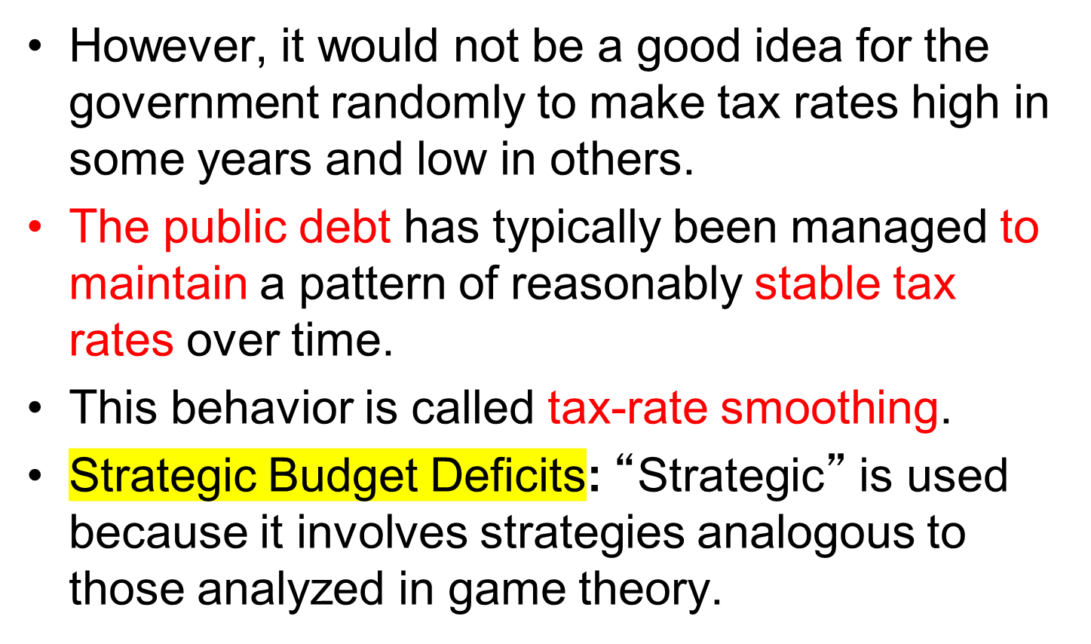
Economic Effects of a Budget Deficit

